Slide 1
5.3 Objects and References

Slide 2
Variables of a Class Type
All variables are implemented as a memory location
For a variable, it has the memory location assigned
If the variable is a primitive type,
A data value is stored in the memory location
If the variable is a class type,
The value stored in the memory location contains memory address of object named by the variable

Slide 3
Variables of primitive type
When declaring a primitive variable, a certain amount of memory is allocated based on the declared type
Actual data values are saved in the allocated memory
 | …
 | …
 | …
int age; | ???
double amount; | ???
char ch; | ??
 | …
 | …
int age; | 256
double amount; | 3.14159
char ch; | 'a'
 | …
int age; double length; char letter;
memory

Slide 4
Variables of a Class Type
Behave differently from variables of a primitive type
Scanner keyboard = new Scanner(System.in);
Student jack = new Student();
String s = “SWDM is nice!”;
At least, you have seen that you can not easily compare two strings
string1 == string2; //BAD
string1.equals(string2); //GOOD

Slide 5
Variables of a Class Type
In a class type variable, the address pointing to the actual object is saved (not the object itself)
String s;
s=“How are you?”;
 | …
String s; | ???
 | …
 | …
String s;
 | …
 | …
 | “How are you?”
 | …
memory

Slide 6
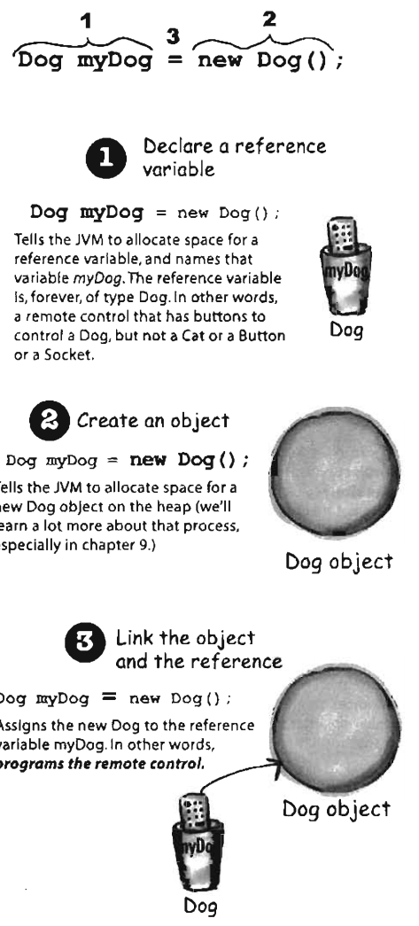
Variables of a Class Type
Variables of class type cont’d
Student s = new Student();
s.setStudent(“Jim Smith”, 2017);
 | …
Student s;
 | …
 | ???
 | ???
 | …
 | …
Student s;
 | …
 | 2017
 | …
 | “Jim Smith”
 | …
memory

Slide 7
Example: Books
Assume that we have a class named Book
Book jacksBook = new Book(“Java”);
Book apusBook = new Book(“Java”);
vs.
Book jacksBook = new Book(“Java”);
Book apusBook = jacksBook;

Slide 8
Objects in Memory
Memory
Book jacksBook;
Book apusBook;
jacksBook = new Book(“Java”);
apusBook = new Book(“Java”);
jacksBook.setPage(137);
apusBook.setPage(253);
apusBook = jacksBook;
apusBook.setPage(509);
jacksBook now has 509 pages!
jacksBook
apusBook
2078
1056
2078
2078
?
?
2078
?
This location of memory is out of reach – it will be recycled by the system
?
?
?
2078
1056
2078
?
?
?
?
?
?
Java
?
Java
?
Java
?
Java
?
Java
137
Java
253
Java
137
Java
253
Java
509

Slide 9
Remember
Variables of a class type contain memory addresses
NOT objects themselves
It is dangerous to use assign operator “=” and equal-to operator “==” on class type variables

Slide 10
== vs. equals() for Strings Explained
String is a class type
What happens when you have
String s1 = new String(“Hello”);
String s2 = new String(“Hello”);
boolean strEqual = (s1 == s2);
strEqual is false! Why?
s1 and s2 store different addresses!

Slide 11
== vs. equals() for Strings Explained
String is a class type
What happens when you have
String s1 = new String(“Hello”);
String s2 = s1;
boolean strEqual = (s1 == s2);
strEqual is true!
s1 and s2 have the same address!

Slide 12
== vs. equals() for Strings Explained
String is a class type
What happens when you have
String s1 = new String(“Hello”);
String s2 = new String(“Hello”);
boolean strEqual = (s1.equals(s2));
strEqual is true! Why?
String’s .equals() method checks if all the characters in the two Strings are the same

Slide 13
Defining equals() method
We cannot use == to compare two objects
We must write a method for a given class which will make the comparison as needed
public class Book {
private String name;
private int page;
public boolean equals(Book book){
return (this.name.equals(book.name) &&
this.page == book.page);
}
}

Slide 14
Defining equals() method
Every class has a default .equals() method if it is not explicitly written
It use “==” to check every pair of instance variables
You decide what it means for two objects of a specific class type to be considered equal
Perhaps books are equal if the names and page numbers are equal
Perhaps only if the names are equal
Put this logic inside .equals() method

Slide 15
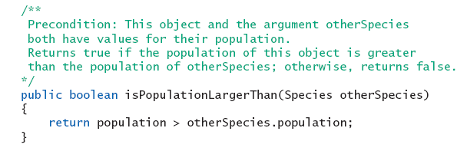
Boolean-Valued Methods
Methods can return a value of type boolean
Use a boolean value in the return statement
Note method from listing 5.19

Slide 16
Lab: define equal method
import java.util.Scanner;
public class Species {
private String name;
private int population;
private double growthRate;
/*The definition of the methods readInput, writeOutput, and predictPopulation
go here.They are the same as in Listing 5.3 and Listing 5.6 . >
< The definition of the methods setSpecies, getName, getPopulation,
and getGrowthRate go here.They are the same as in Listing 5.11 . > */
public boolean equals (Species otherObject)
{
return (this.name.equalsIgnoreCase (otherObject.name)) &&
(this.population == otherObject.population) &&
(this.growthRate == otherObject.growthRate);
}
}
이전에 짠 것이 없으면 강의자료실에서
Species.java 파일 다운로드

Slide 17
Lab: define equal method
Make a main class to test equal method
public class SpeciesEqualsDemo {
public static void main (String [] args) {
Species s1 = new Species (), s2 = new Species ();
s1.setSpecies ("Klingon ox", 10, 15);
s2.setSpecies ("Klingon ox", 10, 15);
if (s1 == s2)
System.out.println ("Match with ==.");
else
System.out.println ("Do Not match with ==.");
if (s1.equals (s2))
System.out.println ("Match with the method equals.");
else
System.out.println ("Do Not match with the method equals.");
System.out.println ("Now change one Klingon ox.");
s2.setSpecies ("klingon ox", 10, 15); //Use lowercase
if (s1.equals (s2))
System.out.println ("Match with the method equals.");
else
System.out.println ("Do Not match with the method equals.");
}
}
1) 두개 종족의 객체 만들기
2) 각 객체에 동일한 객체 이름, 종족수, 증가율 입력
==로 각 객체 비교한 결과 확인
아까 짠 equal 함수로 비교한 결과 확인
객체입력값을 바꾸고
Equal 한지 재 확인

Slide 18
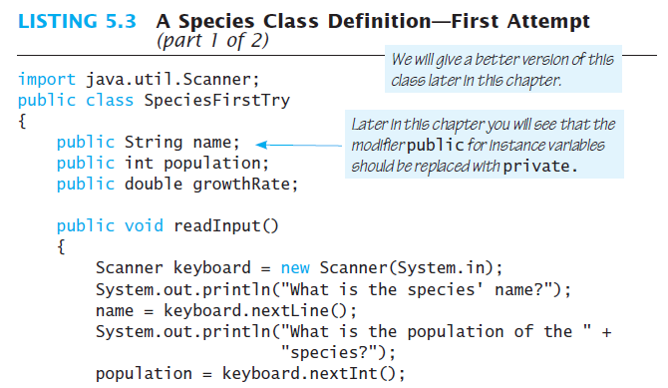
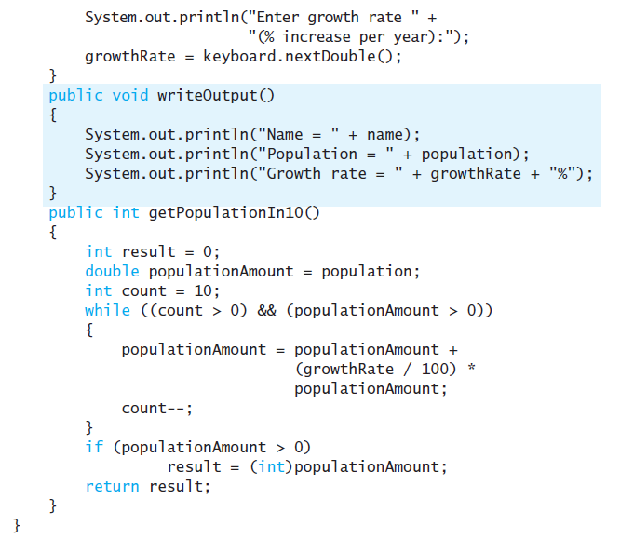
LISTING 5.6 함수 추가
public void readInput () {
Scanner keyboard = new Scanner (System.in);
System.out.println ("What is the species' name?");
name = keyboard.nextLine ();
System.out.println ("What is the population of the species?");
population = keyboard.nextInt ();
System.out.println ("Enter growth rate (% increase per year):");
growthRate = keyboard.nextDouble ();
}
public void writeOutput () {
System.out.println ("Name = " + name);
System.out.println ("Population = " + population);
System.out.println ("Growth rate = " + growthRate + "%");
}
public int predictPopulation (int years) {
int result = 0;
double populationAmount = population;
int count = years;
while ((count > 0) && (populationAmount > 0))
{
populationAmount = (populationAmount +
(growthRate / 100) * populationAmount);
count - - ;
}
if (populationAmount > 0)
result = (int) populationAmount;
return result;
}

Slide 19
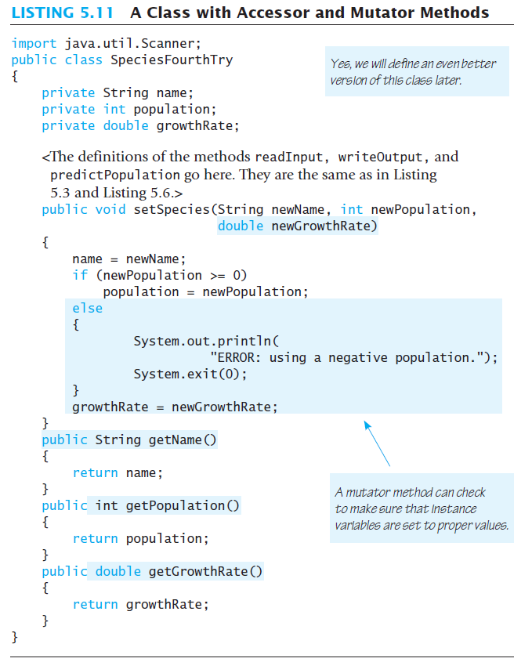

Slide 20
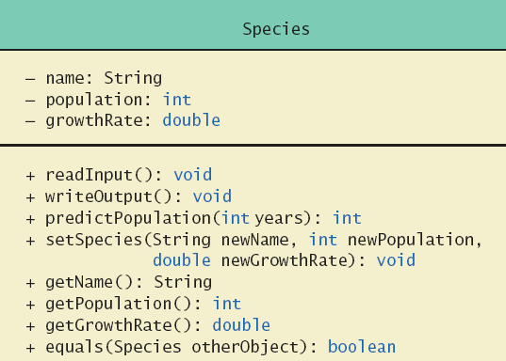
Lab: define equal method
Class Diagram for the class Species in listing 5.17

Slide 21
Parameters of a Class Type
When assignment operator used with objects of class type
Only memory address is copied
Similar to use of parameter of class type
Memory address of actual parameter passed to formal parameter
Formal parameter may access public elements of the class

Slide 22
Parameters of a Primitive Type
Call by value in C!
public void increaseNum(int num)
{
num++; // num is changed
}
public void doStuff()
{
int x = 5;
increaseNum(x);
System.out.println(x);
}
Prints 5. Why?
num is local to increaseNum method; does not change x
void swap(int first, int second) {
int tmp = first;
first = second;
second = tmp;
}
void main() {
int x = 10, y = 20;
swap(x, y);
printf("x = %d, y = %d\n", x, y);
}
?

Slide 23
Parameters of a Class Type
public Book(String name) { this.name = name; }
public void changeBook(Book book){
book = new Book(“Biology”); // book is changed
/*
book = new Book();
book.setName("Biology");
*/
}
public void doStuff() {
Book jacksBook = new Book(“Java”);
changeBook(jacksBook);
System.out.println(jacksBook.getName());
}
Prints Java. Why?
book is local to changeBook, does not change jacksBook
Call by reference in C!
 | …
 | …
 | 2017
 | …
 | “Java”
 | …
 | …
 | …
 | 2016
 | …
 | “Biology”
 | …
Book JackBook;
Book book;
changeBook
(jacksBook);
?

Slide 24
Parameters of a Class Type
Call by reference in C!
public void changeBook(Book book)
{
book.setName(“Biology”);
}
public void doStuff()
{
Book jacksBook = new Book(“Java”);
changeBook(jacksBook);
System.out.println(jacksBook.getName());
}
Prints Biology. Why?
book contains the same address as jacksBook!
Pay attention: the value of book is not changed!
 | …
 | …
 | 2017
 | …
 | “Biology”
 | …
 | …
 | …
 | 2016
 | …
 | “Biology”
 | …
Book JackBook;
Book book;
changeBook
(jacksBook);
Java
?
book.setName
(“Biology”);

Slide 25
Practice 5
EX5_3. Implement a class PersonAddress that represents an entry in an address book.
Attributes
The first & last name of the person (성, 이름)
The e-mail address of the person
The telephone number of the person
Methods
Access each attribute ➔ getter method 3개
Change the e-mail address ➔ update email method 1개
Change the telephone number ➔ change number method 1개
Test whether two instances are equal based solely on name ➔ equal method 1개

Slide 26
Practice 5
EX5_3. Implement the class
public class PersonAddress {
// instances 선언
// method 구현
public void initialize(String first, String last, String email, String phone) { }
public String getFirstName(){ }
public String getLastName(){ }
public String getEmailAddress(){ }
public String getPhoneNumber(){ }
public void updateEmail(String newEmail){ }
public void updatePhone(String newPhone){ }
public boolean equal(PersonAddress other){ }
}
public class PersonAddressTest {
// Main 함수 만들기
public static void main(String[] args) {
// person address 객체 2개생성
// 초기화 // person 1 정보 불러오기
// person 2 정보 불러오기
// person 1 과 2 비교
// person 1의 이메일 업데이트
// person 2의 전화번호 업데이트
}
}

Slide 27
Practice 5
EX5_3. Write a method and its precondition and postconditions.
public String getFirstName()
Precondition: none.
Postcondition: The first name was returned.
public String getLastName()
public String getEmailAddress()
public String getPhoneNumber()
public void updateEmail(String newEmail)
Precondition: none.
Postcondition: The email address was changed to newEmail.
public void updatePhone(String newPhone)
public boolean equal(PersonAddress otherPerson)
Precondition: otherPerson is not null.
Postcondition: True was returned if the first and last names match.

Slide 28
Summary
Classes have
Instance variables to store data
Method definitions to perform actions
Instance variables should be private
Class needs accessor, mutator methods
Methods may be
Value returning methods
Void methods that do not return a value

